Slide 1
On Demand Car Wash Platform
Prepared By
Korrai Bhargav
Vutukuri Naga Venkata kasi Amarnadh kumar
Imam Gouse Peddarumala shaik
Sujeet Kumar
Jami mutyalarao
Sudesh K
Adrija Biswas
Priyank Joshi
Neetu kumari
Durgesh kumar

Slide 2
Table of Contents:
Introduction
Problem Statement
Proposed System
Technologies
Use Case Diagrams
Sequence Diagram For Customer
Sequence Diagram For Admin
Sequence Diagram For Washer
Technology Used
Output Diagram
Conclusion
References

Slide 3
Introduction
You can get your car washed wherever you are at your convenience. Whether it's your home, salon, office or any other place, your car wash is just a few taps away. Few moments spend in signup can save your valuable time. All you need to do is just enter your car, address, and payment details. A washer will come at your location and give your car a premium wash. The app also contains various packages and add-ons to wipe, clean and dress your entire car from inside out

Slide 4
Problem Statement
Today, with the changing preferences and growing income, people are likely to roam around in sedans and SUV's. With the increasing car consumer market, car wash segment is all set to join the race. Forecasting the expanding markets of the car care services, Green Carwash company approached Hyperlink Info System to develop an interface that connects customers and service providers to avail the best wash services within the nearest proximity. The main aim of the client is to explore the untapped market opportunities by satisfying increasing consumer demands through professional car wash services. The app is developed on Android platforms and designed for the USA audience only.

Slide 5
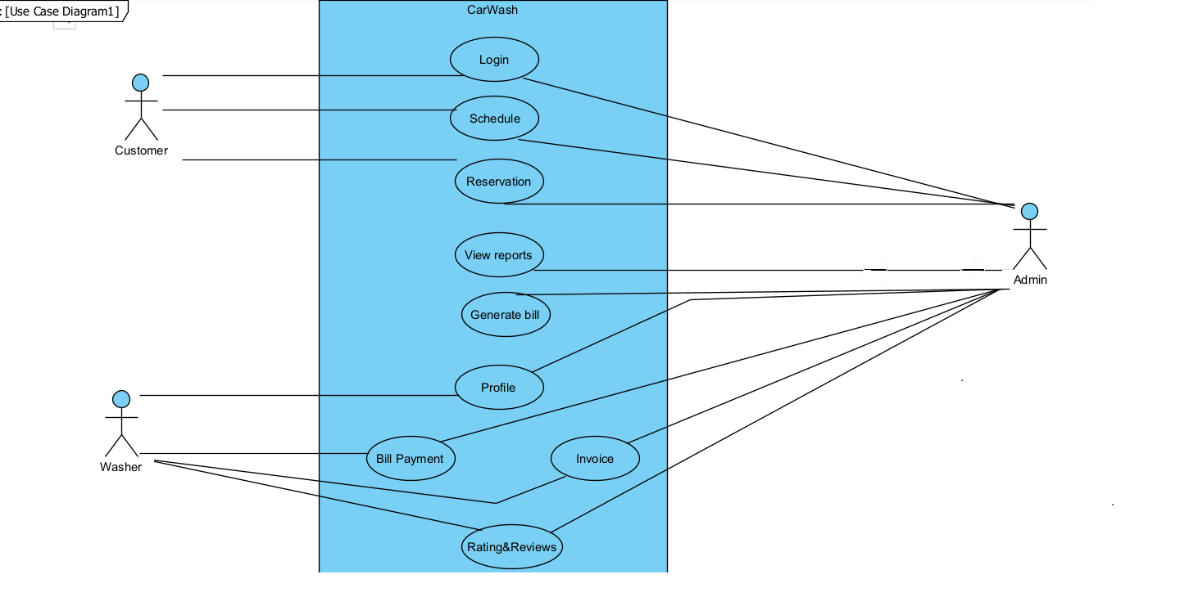
Use Case Diagram

Slide 6
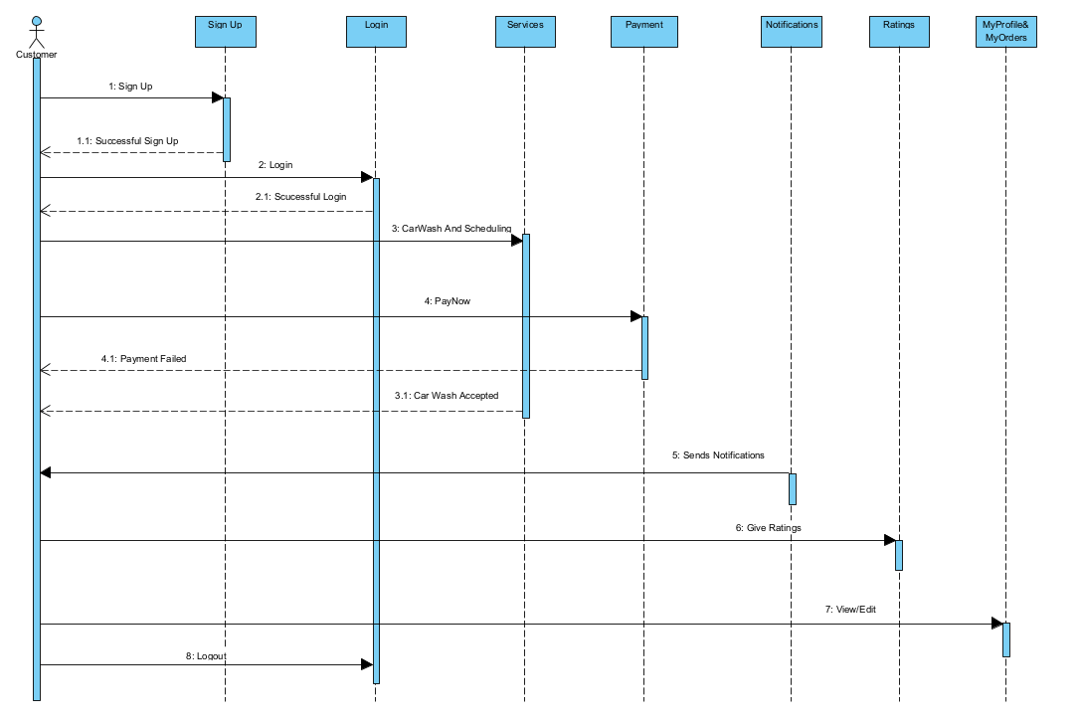
Sequence Diagram For Customer

Slide 7
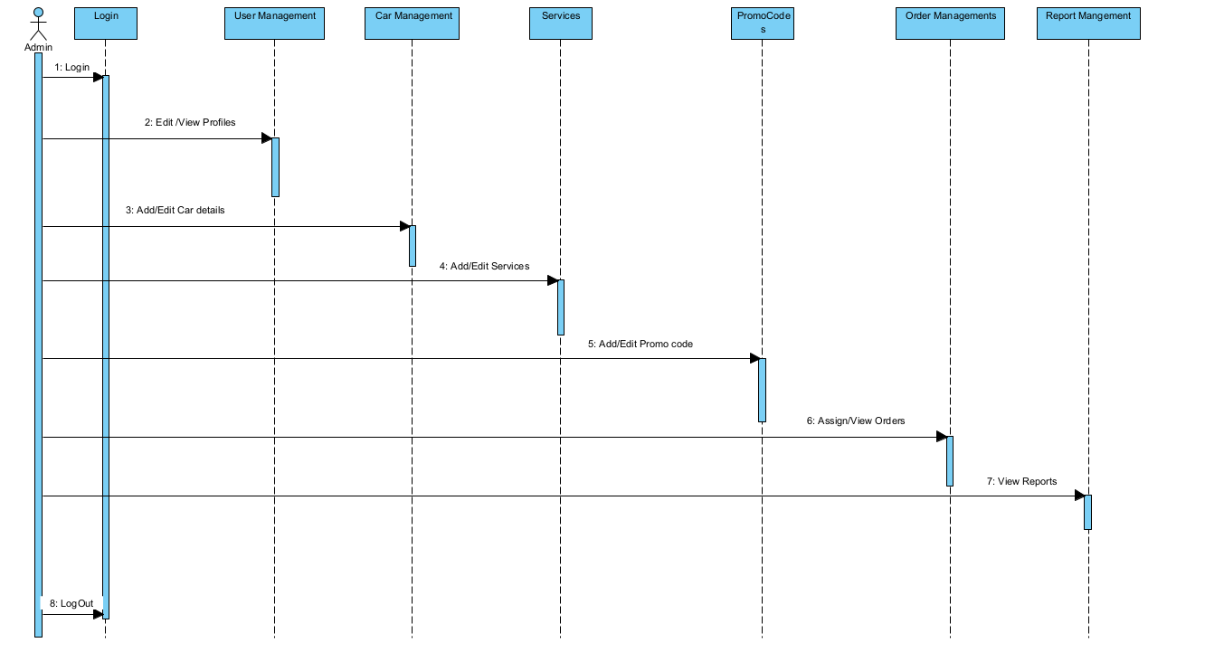
Sequence Diagram For Admin

Slide 8
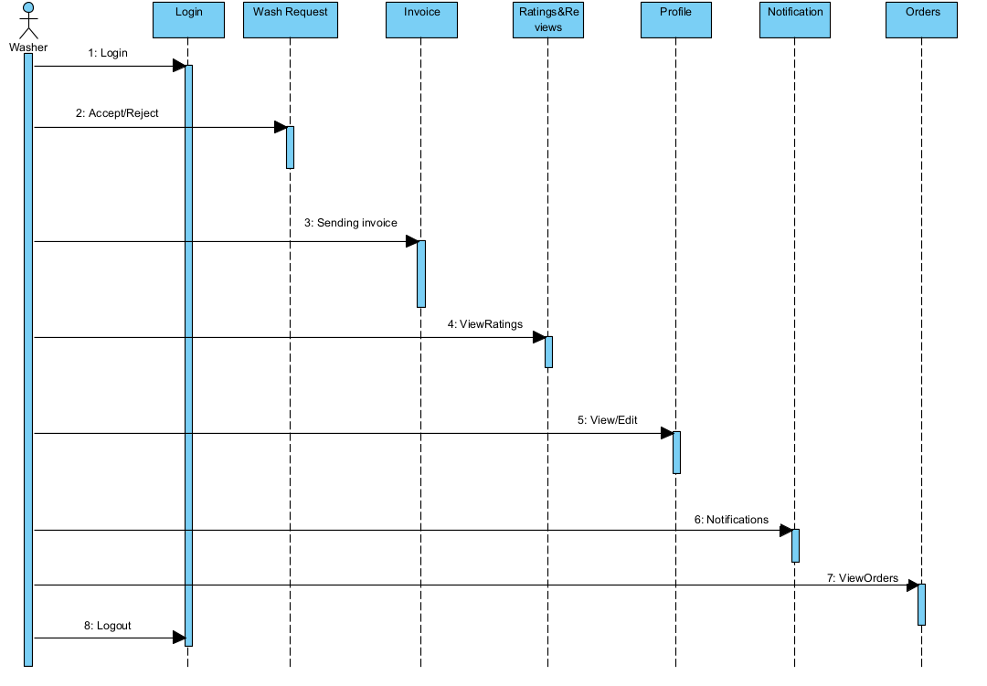
Sequence Diagram For Washer

Slide 9
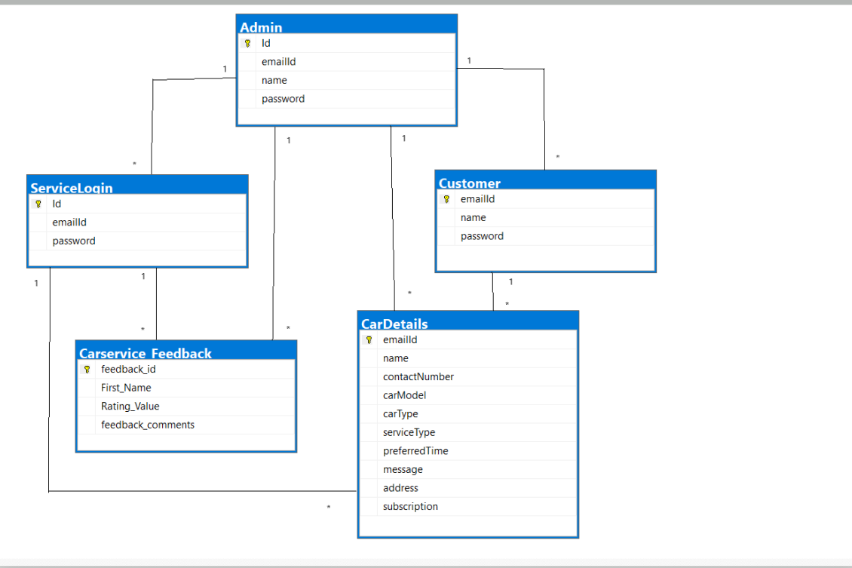
Database Diagram

Slide 10

Technology used for implementation
Front-End: html5, CSS3, Angular
Database: SQL Server
Back-End: Asp.net Core Web API
Browser Compatibility: All Browser Compatible

Slide 11
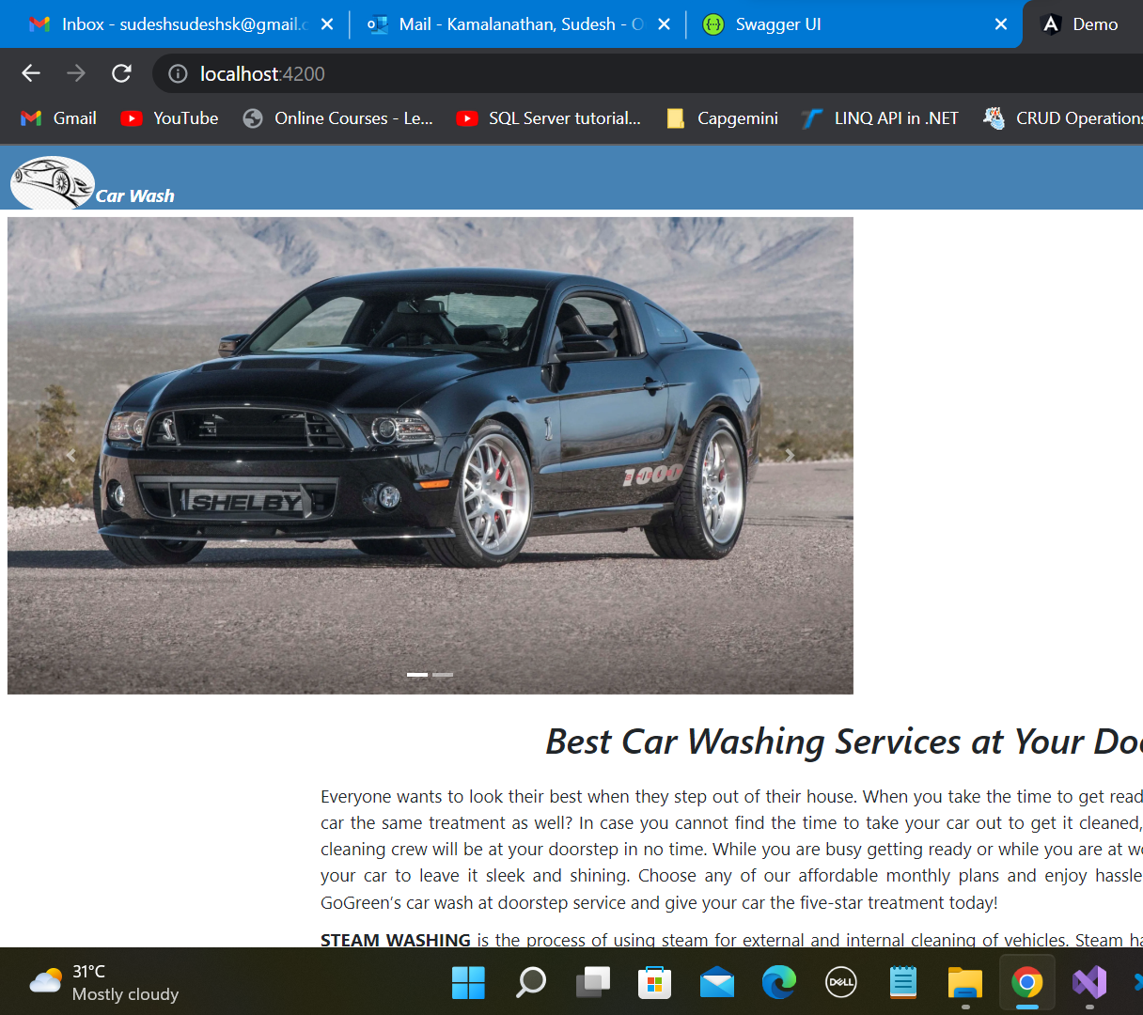
Home Page

Slide 12
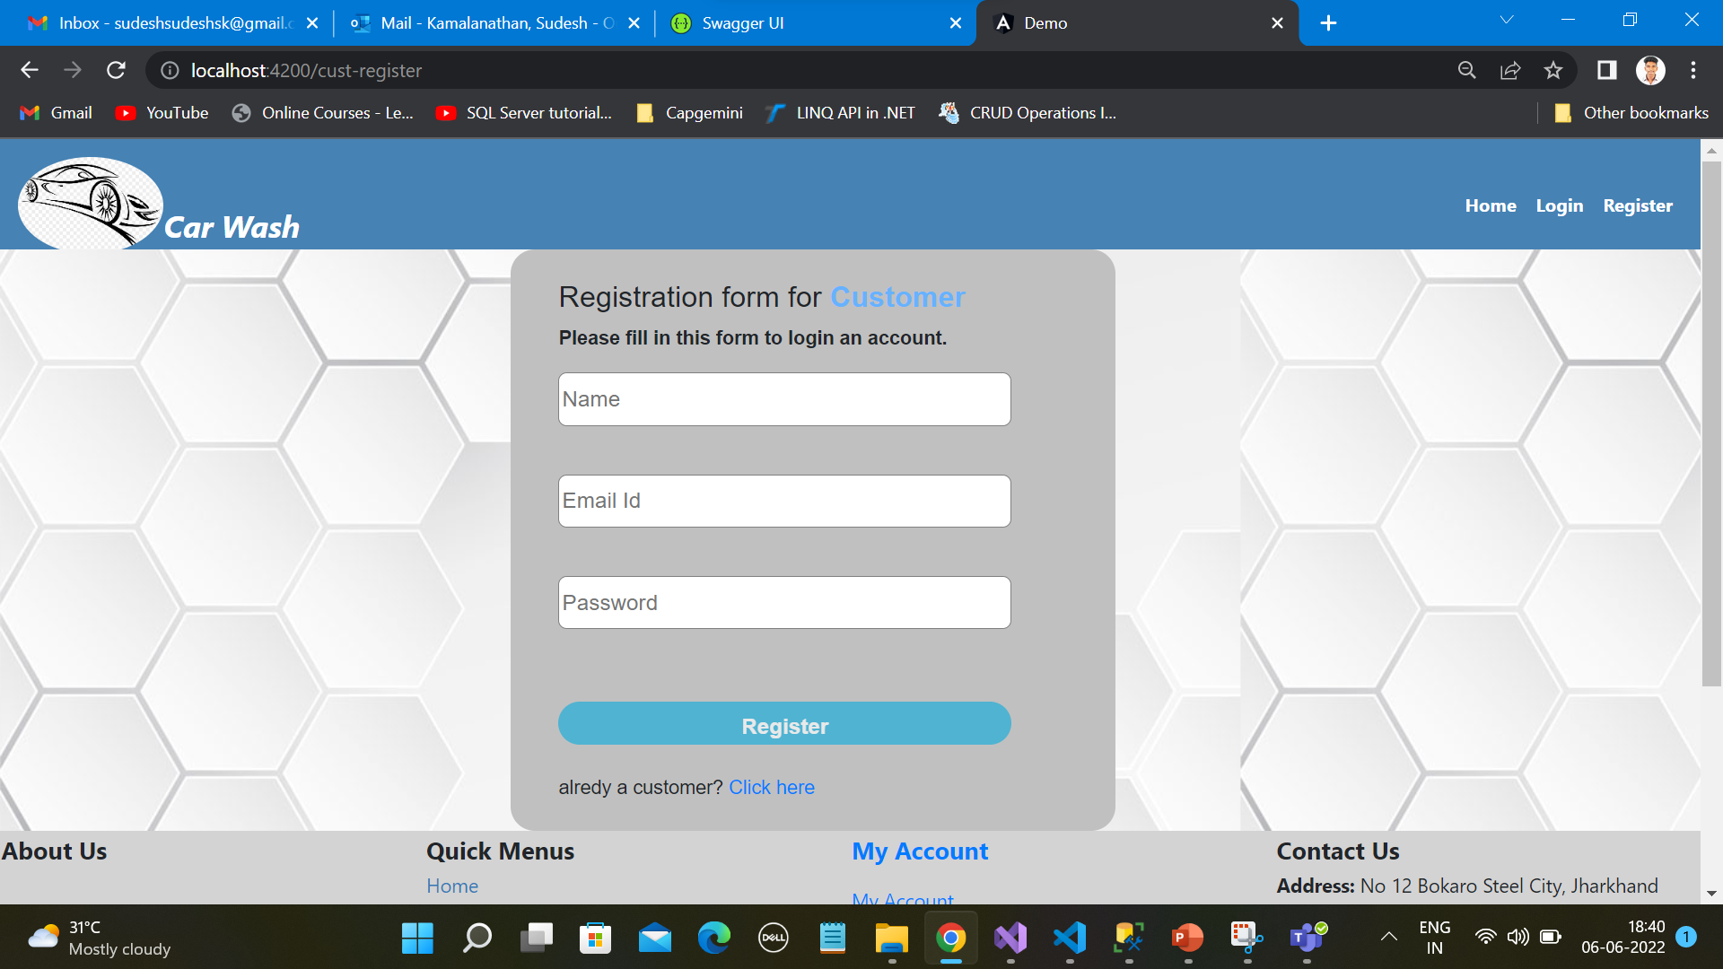
Customer Registration Page

Slide 13
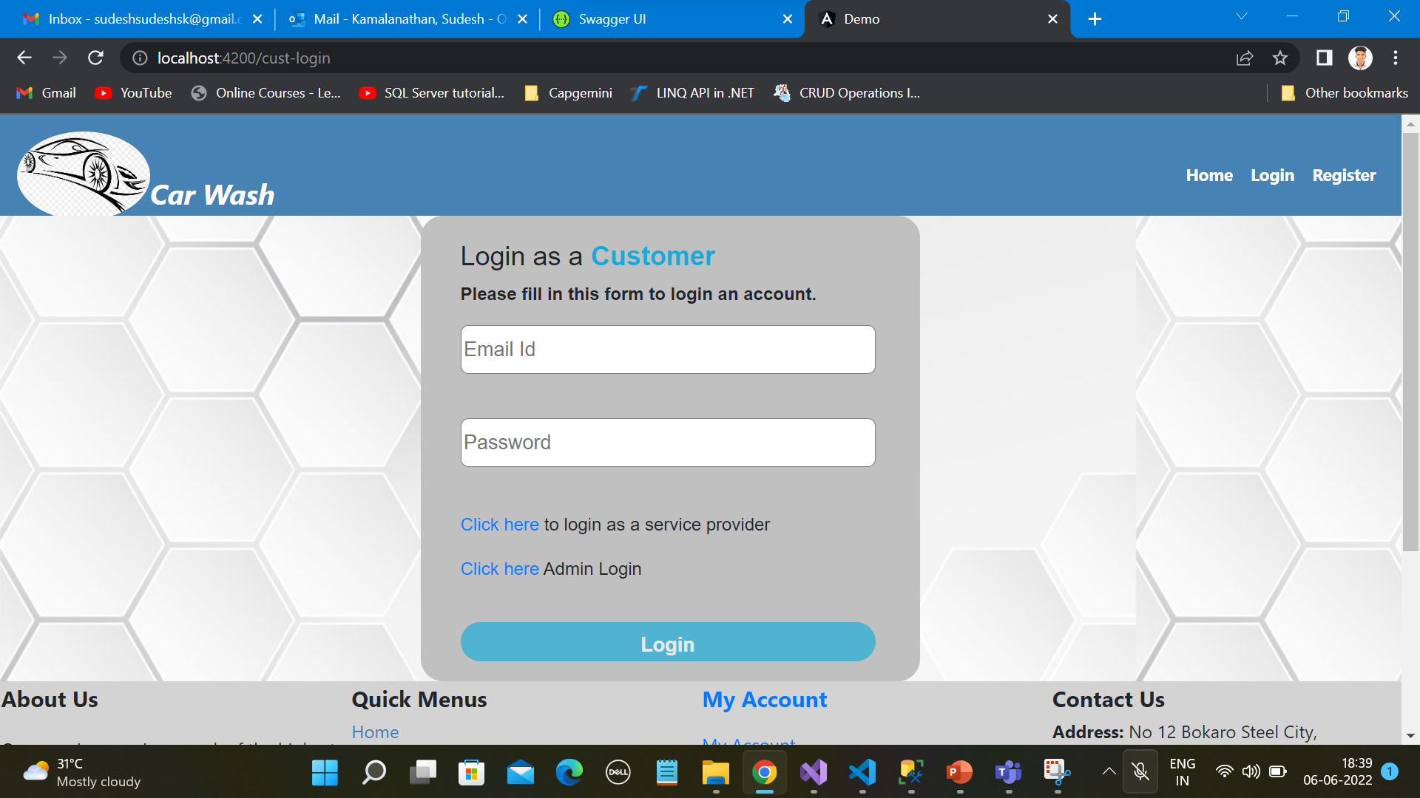
Customer Login

Slide 14
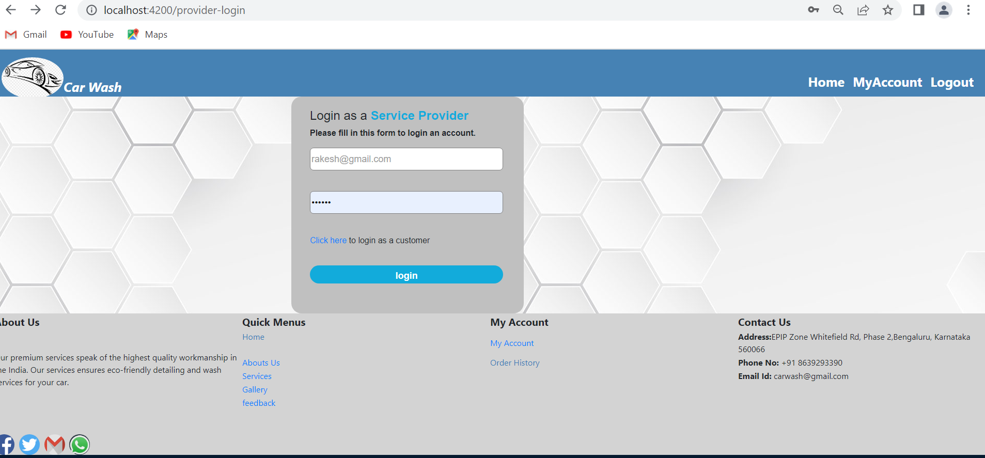
Washer login

Slide 15
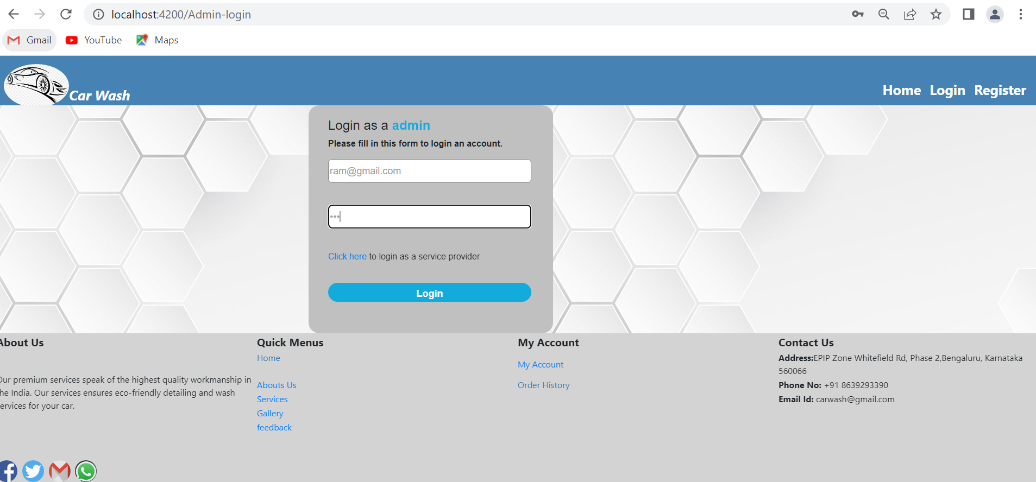
Admin Login

Slide 16
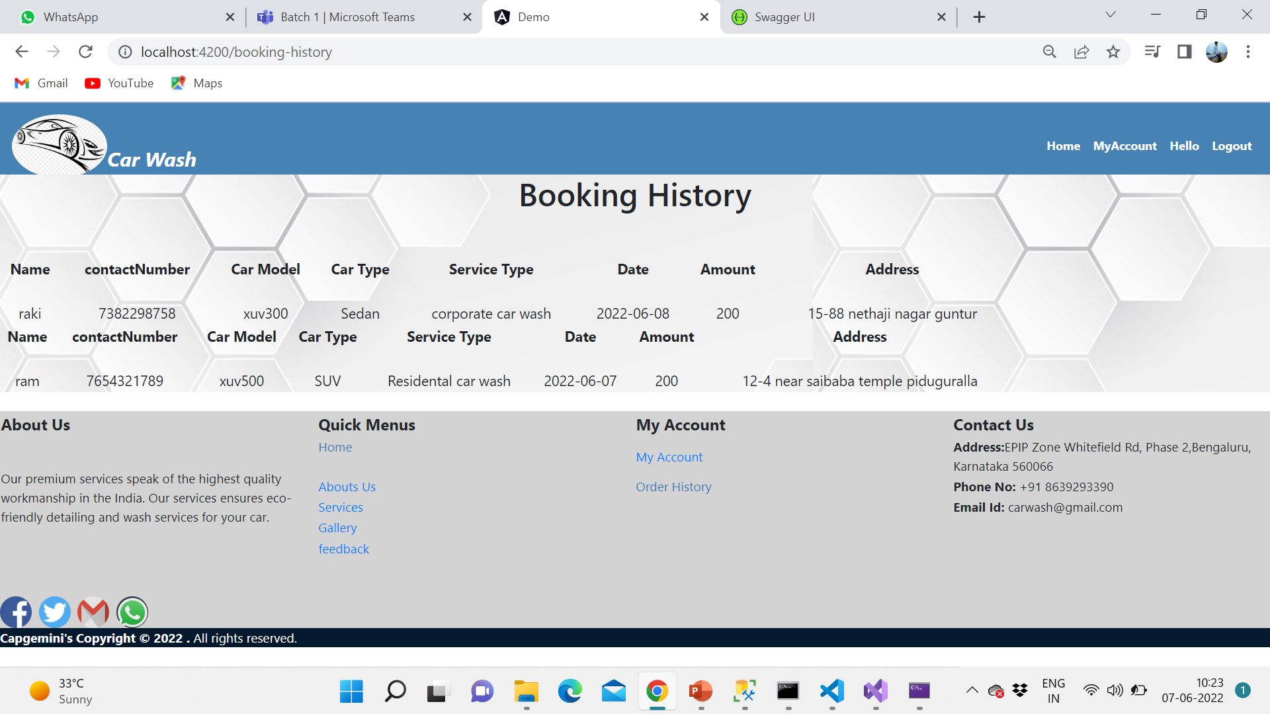
Booking History Page

Slide 17
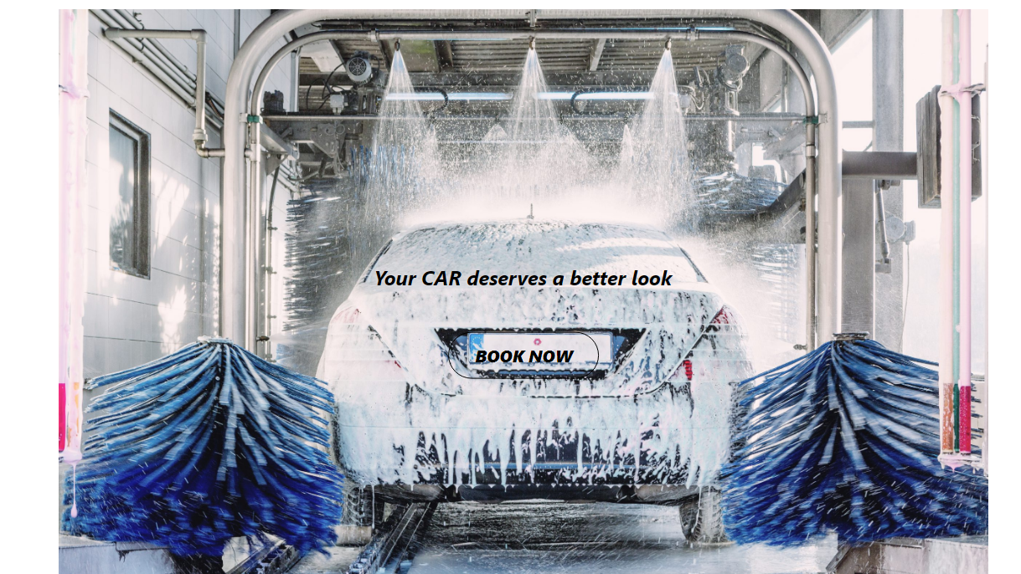

Slide 18
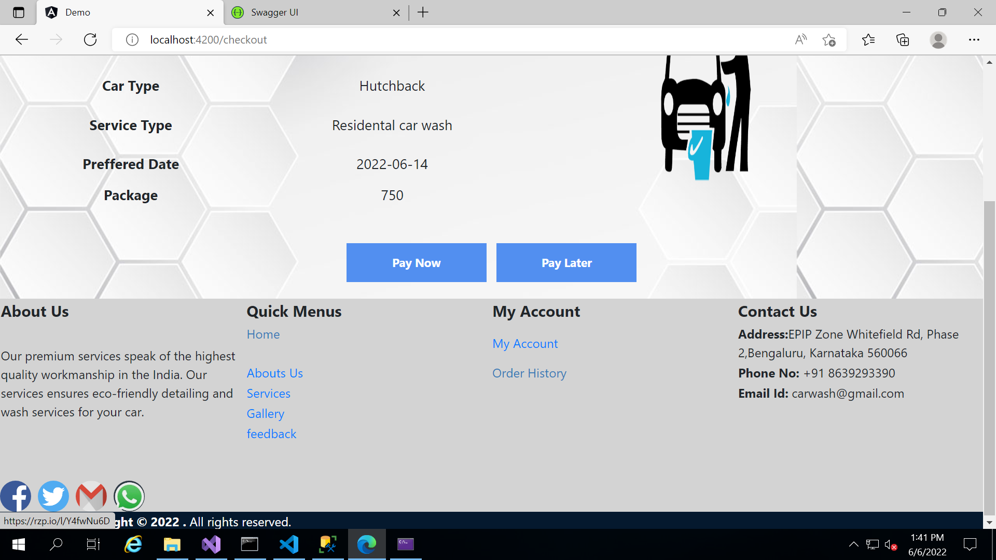
Payment Page
Click on Pay Now button for online payment

Slide 19
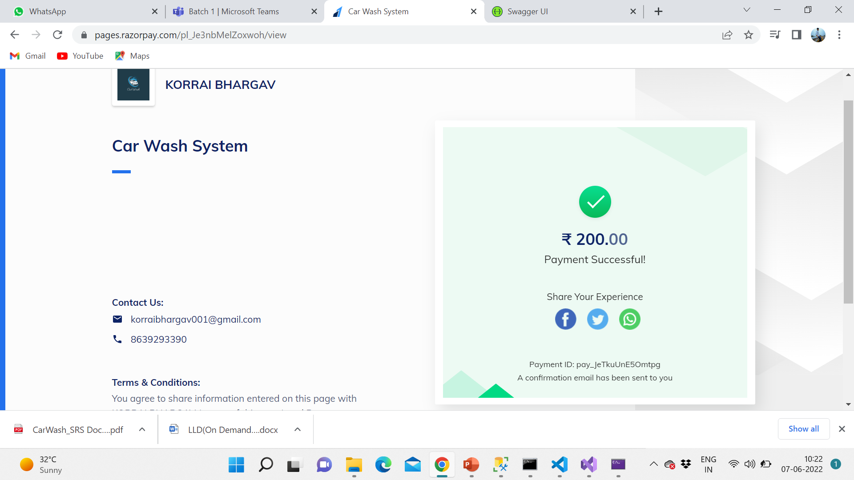
It will redirect you to RazorPay payment gateway

Slide 20
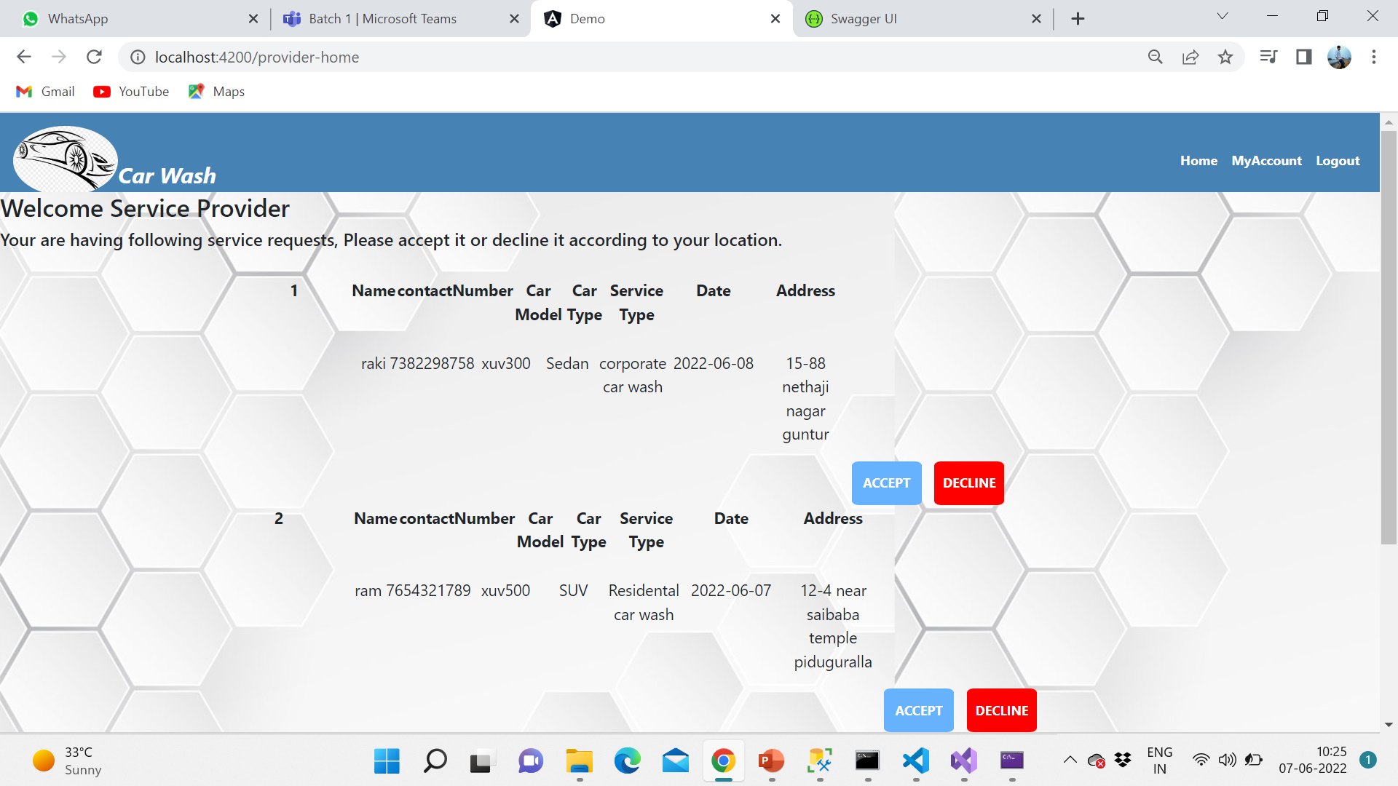
Accept and Reject page
After log in as a service provider a list of orders is displayed, You may accept or decline the order

Slide 21
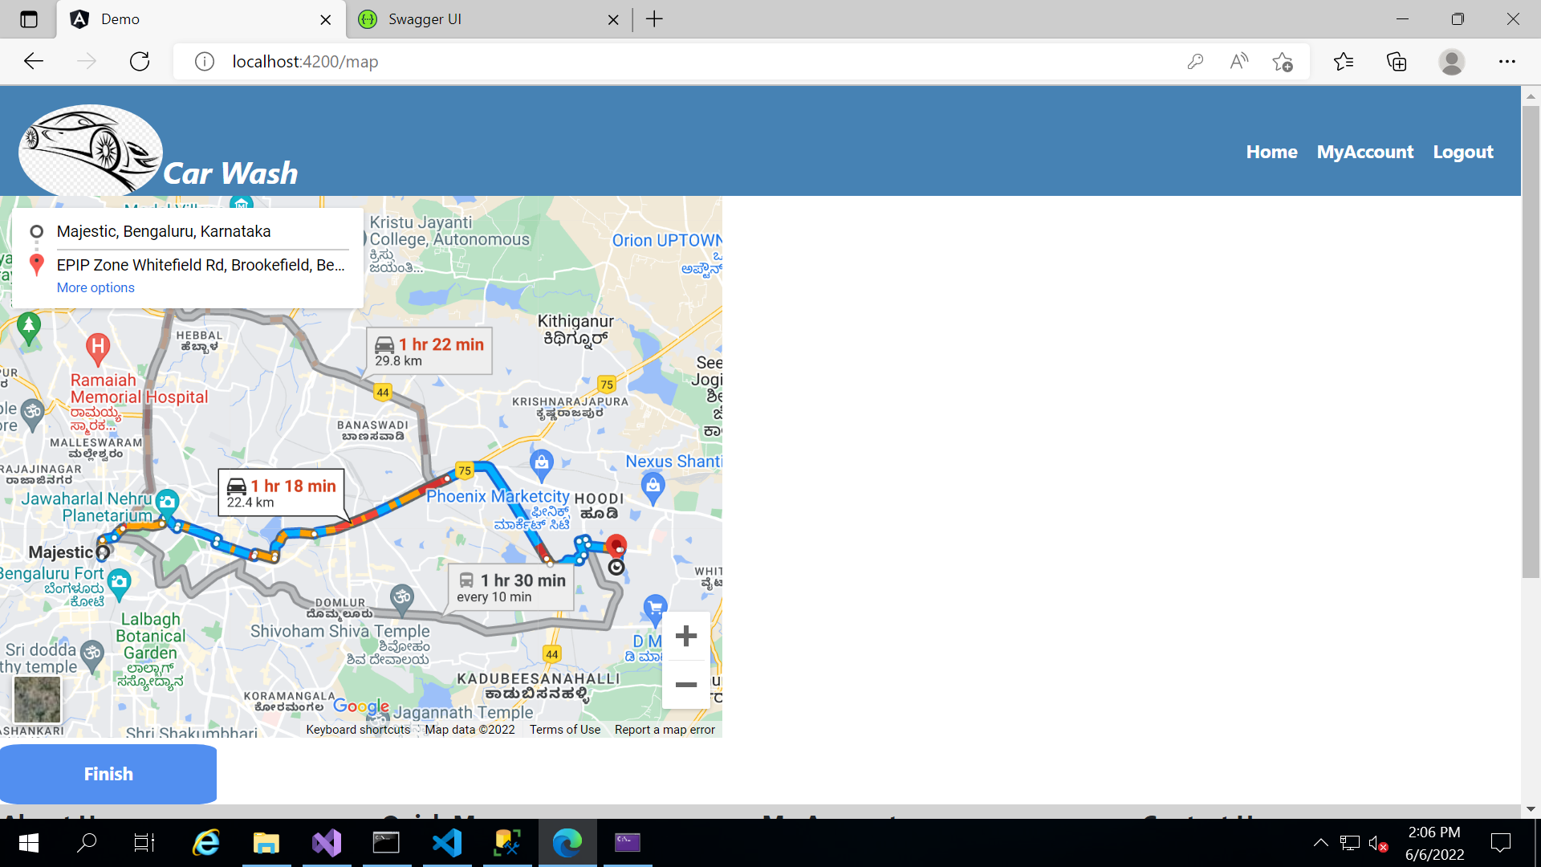
MAP Display Location
After accepting an Order the address of Customer will be Displayed Here

Slide 22
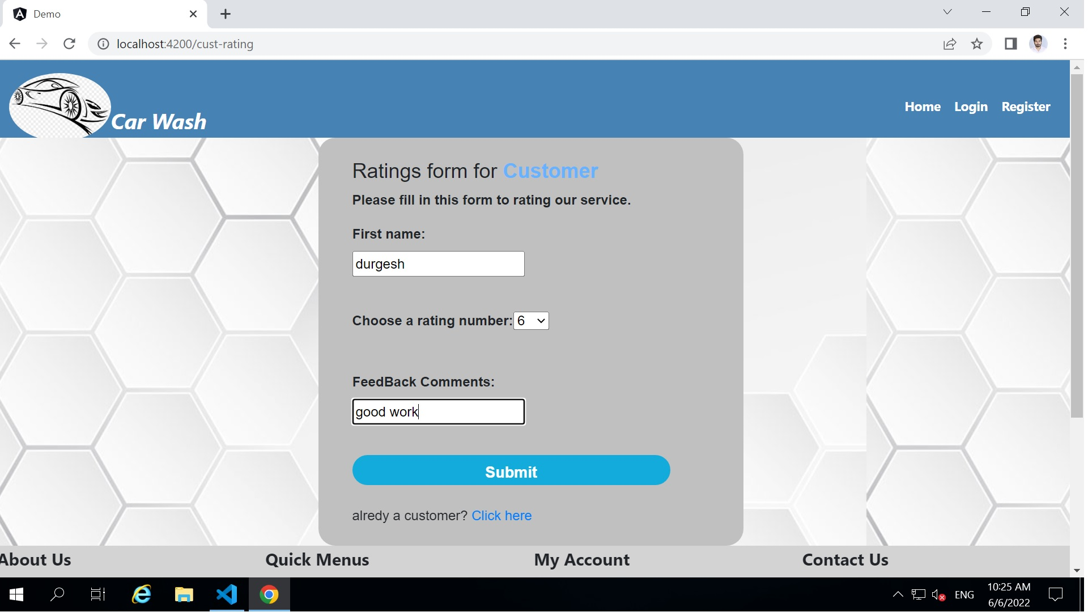
Customer Feedback

Slide 23

Conclusion
The Main Objective of this Project to flexible the Car Wash . Whether it's your home, salon, office or any other place, your car wash is just a few taps away. Few moments spend in signup can save your valuable time. All you need to do is just enter your car, address, and payment details. A washer will come at your location and give your car a premium wash.

Slide 24
References
https://www.w3schools.com/html/
https://www.w3schools.com/w3css/
https://www.w3schools.com/js/
https://codewithmosh.com/p/the-ultimate-typescript
https://programmingwithmosh.com/angular/
https://www.tutorialsteacher.com/webapi
https://www.pluralsight.com/paths/aspnet-core
https://codewithmosh.com/p/entity-framework
http://www.softwaretestinghelp.com/
https://www.guru99.com/
https://www.geeksforgeeks.org/

Slide 25


